Slide 1

Healthcare IoT Solution for Athletes
NTI

Slide 2

Supervisor Dr. Mohamed
Project team
Nada Mohamed El-Basel Hegazy | Eslam Ashraf AbdulRaziq Hassan Elsawy | Ahmed Saeed Farg Hassan | Abdullah Mohammed Abdullah Abdelghany
01277019240 | 01021688667 | 01008187248 | 01122095771
nadamohamed070@gmail.com | eslam.elsawy.fe@gmail.com | engahmedsaeed99@yahoo.com | Abdullahqabbaniii@gmail.com

Slide 3
Overview
Healthcare technology is very popular in this pandemic situation because of coronavirus.
health care technology is rapidly being revolutionized with the help of the Internet of Things (IoT). Monitoring the health status of a covid patient is a hard task because of our busy schedule and our daily work. Mostly, the elderly covid patients should be monitored periodically.
So I thought to make an innovative system in this lockdown to automate the task. This device uses an ESP8266 webserver to track patient health using this monitoring system.
Hence, patient health parameters such as body temperature, heart rate (BPM), blood oxygen levels (Sp02) as well as room temperature and humidity can be monitored from any device (like Smartphone, PC, Laptop, Smart TV,.) That support browsing capabilities.

Slide 4
Node red apps
Player Status

Slide 5
ESP8266 based Patient Health Monitoring System
Today’s project is all about ESP8266 based Patient Health Monitoring System using
MAX30100
Pulse Oximeter sensor,
DS18B20 temperature sensor,
and DHT22 Temperature & Humidity sensor.
This system will monitor the parameters like room temperature, room Humidity, Heart Rate, Oxygen Saturation (Sp02) in blood, and body temperature of patients on the ESP8266 Webserver

Slide 6
Components Required
Pulse Oximeter Sensor
Breadboard
DHT22 Humidity Temperature Sensor
DS18B20 Temperature Sensor
Healthcare
DS18B20 Waterproof
Temperature Sensor
Jumper Wires

Slide 7
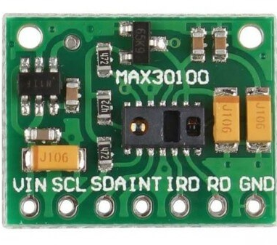
MAX30100 Pulse Oximeter Sensor
MAX30100 is an integrated Pulse Oximetry and Heart Rate monitor sensor solution. It requires a 1.8V to 3.3V power supply to operate. Also, we can power it down through program code by decreasing its standby current and providing a power supply all the time. This oximeter sensor has two LEDs, photodetector optimized optics, and low-noise-analog signal processing to detect heart-rate signals.
How does MAX30100 Pulse Oximeter work?
The MAX30100 Pulse Oximeter has two built-in LEDs, in which one emits red light and the other emits infrared light. To measure pulse rate, only infrared light is required. But, both red light and infrared light are used to measure oxygen saturation (Sp02) levels in the blood. When the heart pumps the blood, there is more oxygenated blood and when the heart rests, the amount of oxygenated blood also gets decreased. Hence, by knowing the time between the rise and fall of oxygenated blood, we determine the pulse rate

Slide 8
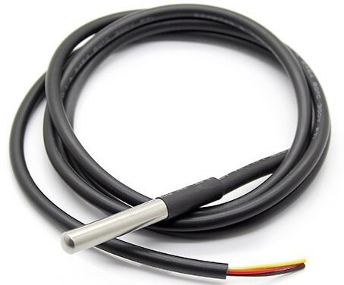
MAX30100 Pulse Oximeter Sensor
This is a pre-wired and waterproof version of the DS18B20 sensor. This sensor is useful for measuring temperature from -55°C to 125°C (-67°F to +257°F) even in wet conditions. It has a long wire, so it’s useful when a patient is a little far. Actually, the cable of this sensor is jacketed in PVC.
DS18B20 is a digital sensor, so there is no signal degradation in long distances. It is fairly precise, i.e. ±0.5°C over much of the range. This sensor works great with any microcontroller using a single digital pin. The downside is it uses the Dallas 1-Wire protocol, which is complex and requires a bunch of code to communicate

Slide 9
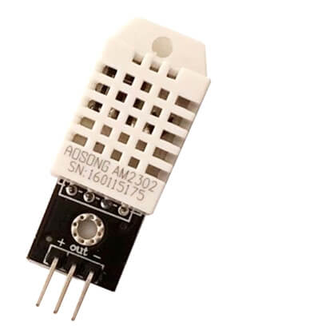
DHT22 Temperature & Humidity Sensor
The DHT22 is a simple, ultra-low-cost digital temperature & humidity sensor. DHT22 uses a capacitive humidity sensor and a thermistor to measure the surrounding temperature and humidity. It sends data in digital signal form so no analog input pin is required.

Slide 10
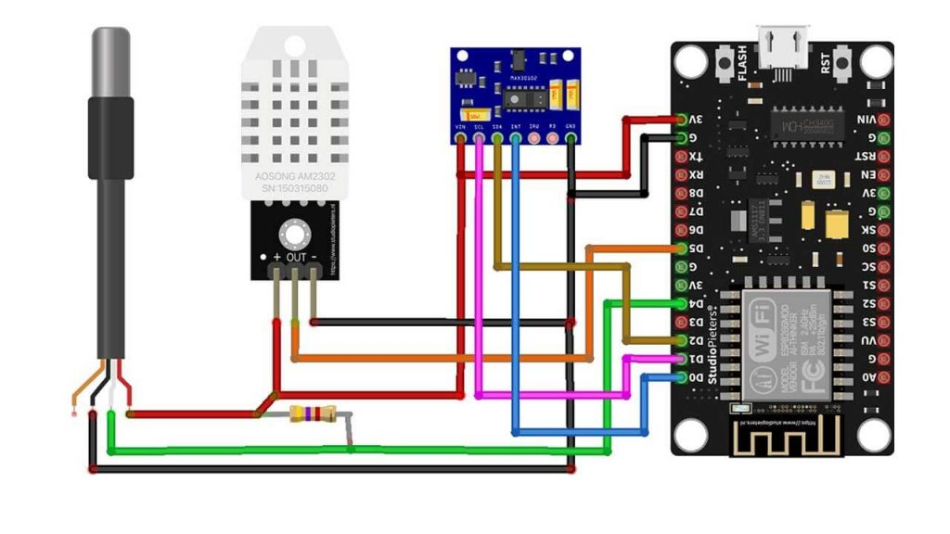
Circuit Diagram: ESP8266 based Patient Health Monitoring System

Slide 11
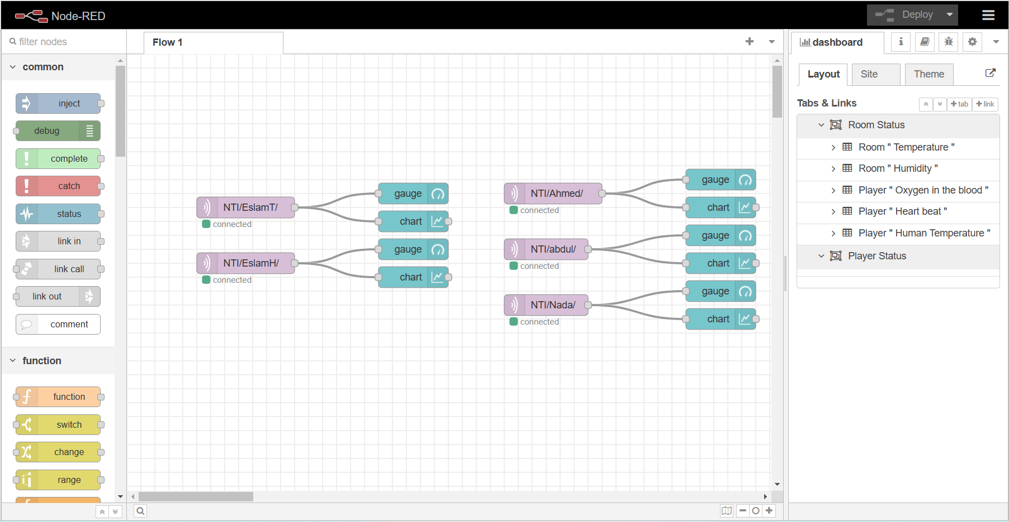
NODE RED DESIGN

Slide 12
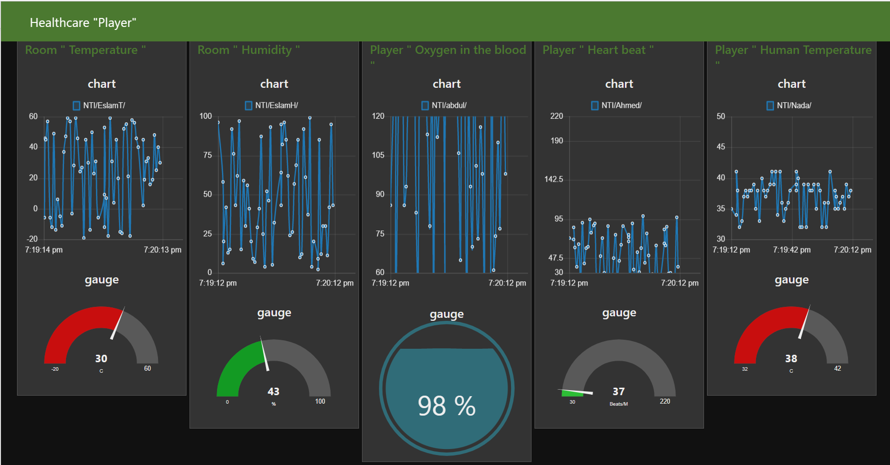
Implementation

Slide 13
السلام عليكم ورحمة الله وبركاته
Thanks

